Slide 1


TellCo Acquisition Analysis
User analytics for an investment decision: overview, engagement, experience and satisfaction
NextHikes IT Solutions | Srishti Sharma
150,001 rows × 55 fields

Slide 2
TellCo
continue due diligence, not yet a buy or pass
106,856
customers in the data (148,935 sessions)
22.8%
of customers are High engagement, carrying about 37% of traffic
40.4%
of customers are in the low-throughput group
19.2%
high-traffic, low proxy score (20,548 customers)
RECOMMENDATION
Continue due diligence
A buy or pass call needs financial data this dataset does not contain.
Usage is real: Apple, Samsung and Huawei cover 90.25% of sessions, and Gaming is about 87% of recorded volume, largely by construction.
The throughput gap is the one robust network finding.
No revenue, cost, churn, ARPU or survey fields exist, so no valuation or retention claim can be made.
Satisfaction here is a behavioral proxy, not measured satisfaction.

Slide 3
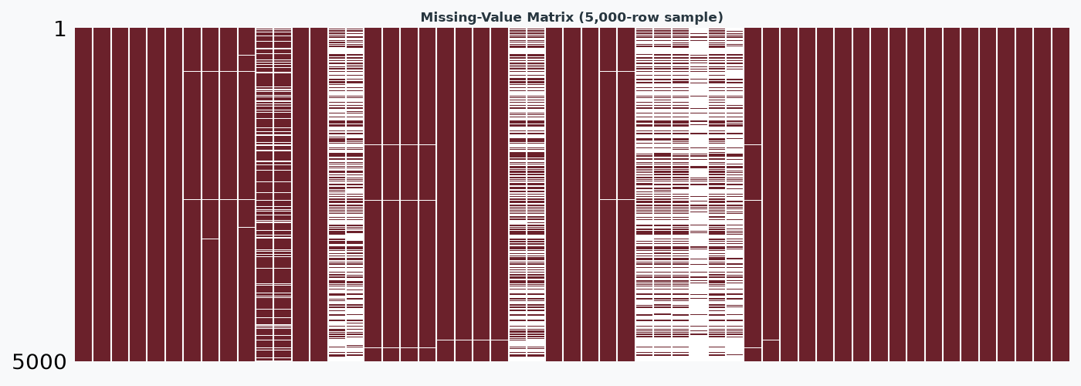
From 150,001 rows to 106,856 customers
150,001
xDR rows in the raw file
148,935
sessions with a customer ID
106,856
customers (1.39 sessions each)
Cleaning rules
Dropped 1,066 rows with no MSISDN (0.71% of rows and of traffic).
Mean-imputed six network and HTTP columns, as the brief requires.
Per-customer outliers beyond 1.5×IQR replaced with the non-outlier mean, as the brief requires: 16,033 customers (15.0%) changed.
Bearer Id is not a session or customer key, so counts use MSISDN.
Missing values in the raw data (%)

Slide 4
Four data-quality findings shape every result
One week, not a month
Every session ends 24–30 April 2019, and 98.92% started 23–29 April.
Mean replacement hides heavy users
The 15.0% of customers it changes carry 29.9% of raw traffic.
Treated versus untreated customer table
Metric | Raw | Mean-replaced (primary) | IQR-capped
Gini (volume) | 0.356 | 0.304 | 0.332
Top 10% traffic share | 25.9% | 21.2% | 23.1%
Volume skew | 2.27 | 0.61 | 0.81
App-pair correlations | 0.59–0.74 | 0.31–0.42 | n/a
App counters do not reconcile
They sum to 185% of Total Data Volume: Total DL excludes Other DL, Total UL includes it.
Duration is a bearer-open span
It is in seconds, not milliseconds. 17.17% of sessions last exactly 24 hours.
Treatment lowers concentration and weakens correlations, so heavy-user questions need untreated figures.

Slide 5
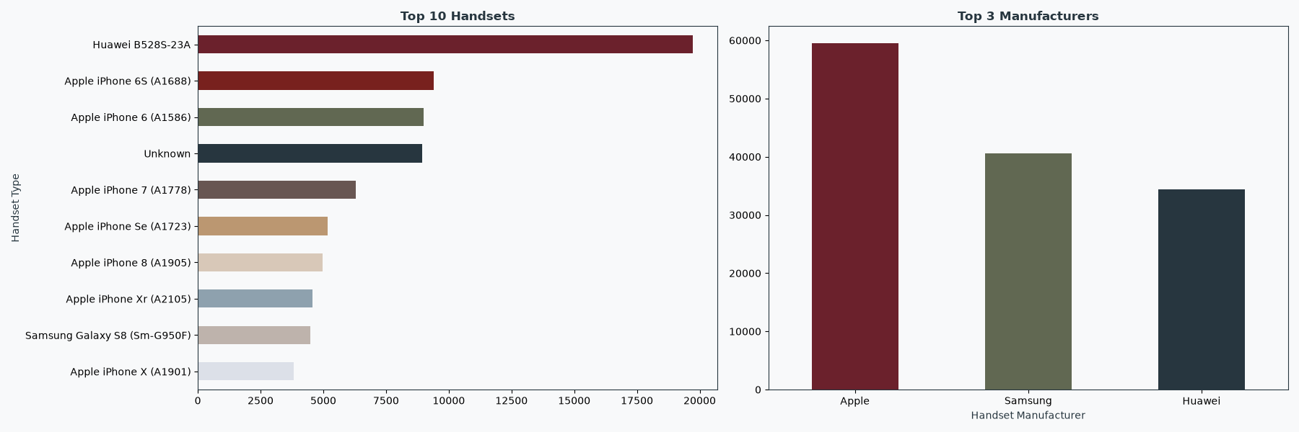
A home router leads handsets,
then previous-generation iPhones
Top 10 by xDR sessions.
'Unknown' (8,931 sessions, 6.0%) is a placeholder for missing handset data, not a device.
13.25%
of sessions are on the Huawei B528S-23A: 19,727 sessions, 10,615 customers (9.9%). It is a fixed-wireless router, not a phone.
Marketing hypotheses to test
Treat the router as its own product line.
Previous-generation iPhones (6S, 6, 7, SE, 8) are the largest upgrade cohort; no current-generation device is in the top five.
8,931 sessions (6.00%) have no usable handset identity.

Slide 6
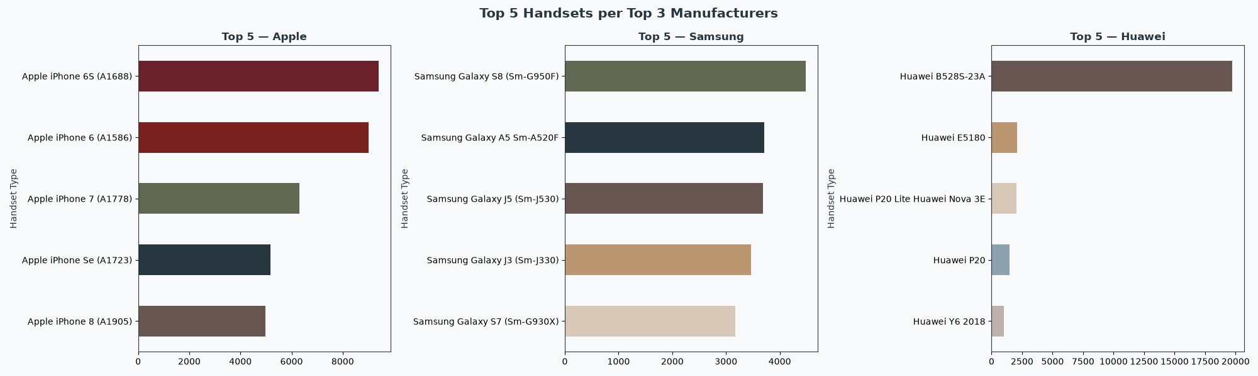
Three manufacturers cover 90.25% of sessions
Share of sessions (%)
Apple | Sessions | Samsung | Sessions | Huawei | Sessions
iPhone 6S | 9,413 | Galaxy S8 | 4,480 | B528S-23A | 19,727
iPhone 6 | 9,012 | Galaxy A5 | 3,708 | E5180 | 2,074
iPhone 7 | 6,304 | Galaxy J5 | 3,682 | P20 Lite | 2,018
iPhone SE | 5,176 | Galaxy J3 | 3,464 | P20 | 1,479
iPhone 8 | 4,985 | Galaxy S7 | 3,176 | Y6 2018 | 997
Huawei's total is dominated by one router model.
App mix is near-identical across the three brands: manufacturer explains usage intensity, not what people use.

Slide 7
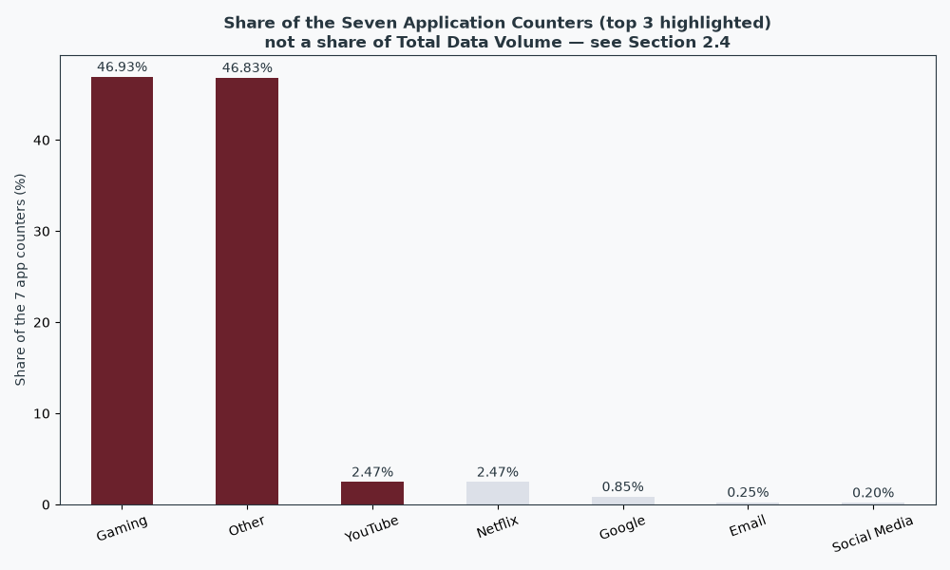
Gaming and Other
are 93.8% of the app counters
How to read this
This is a share of the counter sum, not of total traffic.
Top three named applications: Gaming, YouTube, Netflix.
YouTube and Netflix have near-identical means and spreads, as do Gaming and Other, yet they correlate only 0.42 and 0.31.
The counters may be synthetic or evenly split: ask TellCo how they are defined.

Slide 8
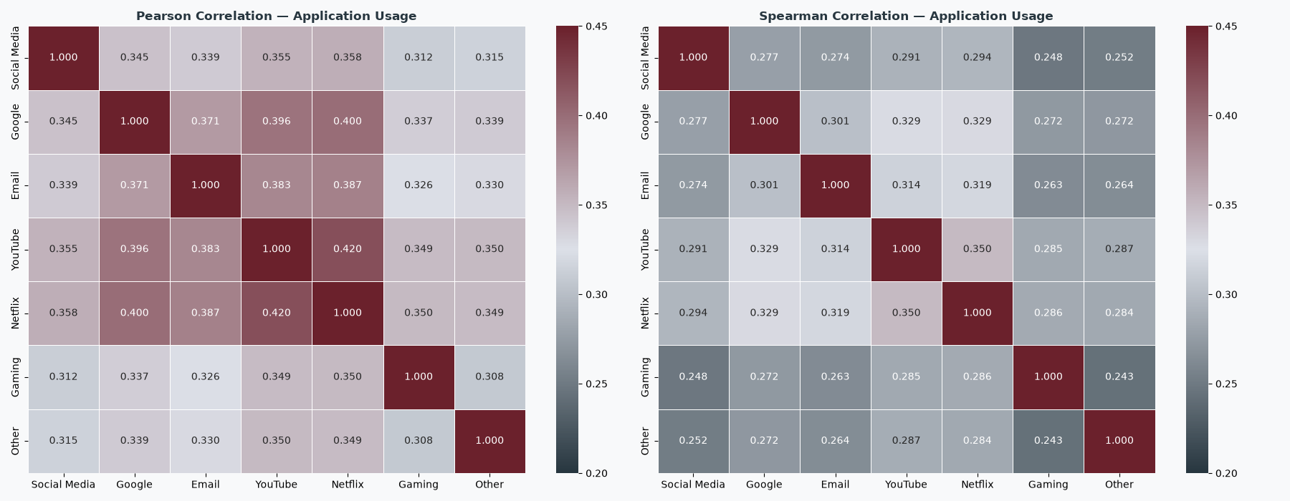
Only Gaming tracks total volume;
usage is skewed
Per customer, before treatment
Metric | Mean | Median | CV | Skew
Sessions | 1.39 | 1 | 0.58 | 3.35
Duration (s) | 146,167 | 102,740 | 1.27 | 20.54
Total data (MB) | 691 | 618 | 0.71 | 2.27
Gaming is about 87% of total volume, so r = 0.983 is largely arithmetic.
Per session, the other six apps fall to 0.056–0.090: they look heavy because customers connect often.
Mean exceeds median on every measure: a few heavy customers pull averages up.

Slide 9
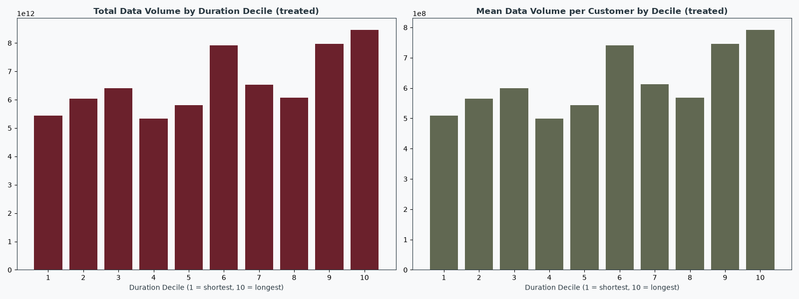
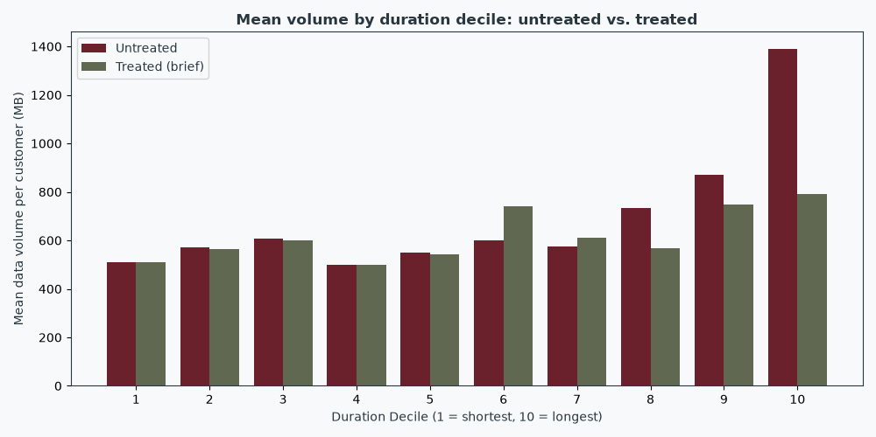
Top duration deciles carry more data,
not steadily
56.0%
of treated traffic sits in the top five deciles (60.4% raw)
20.13%
of raw traffic sits in decile 10 alone
75.4%
of true top-10% duration customers were replaced by the mean

Slide 10
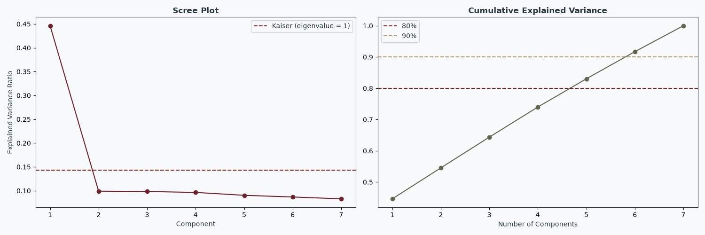
One volume factor,
but only 45% of variance
PC1 loadings by application
PC1 explains 44.6% of variance and every app loads positively (0.36–0.40): an overall data-appetite factor.
PC2 contrasts Gaming (+0.86) with Other (−0.44). PC3 is mostly Other (+0.81).
Five components are needed for 80% and six for 90%, so compression is weak (KMO 0.88).
On untreated data PC1 is 70.7% and three components reach 80%: the weak compression is mostly a treatment effect.

Slide 11
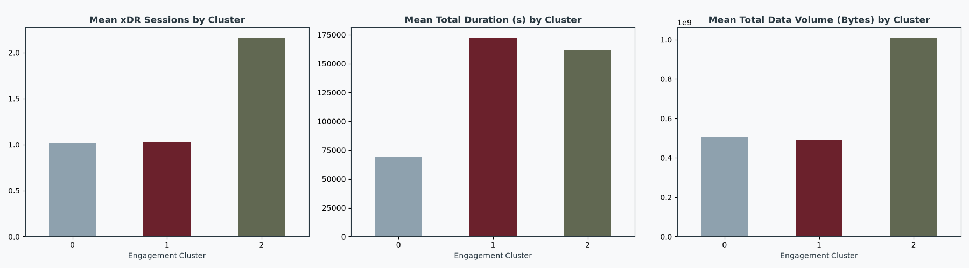
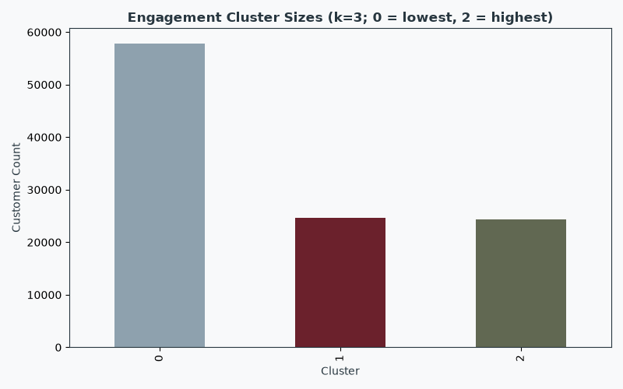
Three engagement groups,
but only one is truly high
High group leads
It leads on sessions and traffic, moving about 2× the data per customer.
Not a ladder
The first two groups have the same sessions and traffic, but the long-hold group's connections stay open about 2.5× longer.
Treat with caution
Duration is partly a system artefact: 17.17% of sessions last exactly 24 hours.
Group | Customer | Avg sessions | Avg duration (s) | Avg data (MB) | Total (TB) | Traffic share
Low engagement | 57,834 (54.1%) | 1.02 | 69,489 | 506 | 29.2 | 44.3%
Long-hold, light traffic | 24,654 (23.1%) | 1.03 | 172,768 | 491 | 12.1 | 18.3%
High engagement | 24,368 (22.8%) | 2.17 | 161,850 | 1,011 | 24.6 | 37.3%

Slide 12
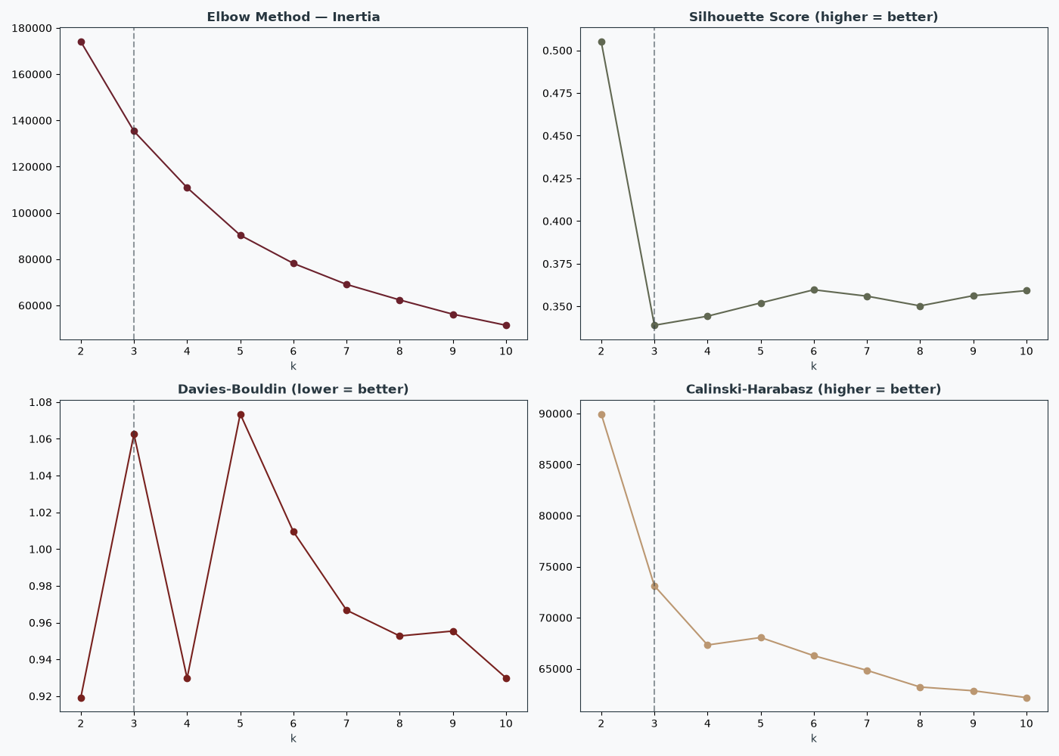
The elbow points to k = 5; k = 2 validates best
Within-cluster inertia by k
Silhouette
0.505 at k = 2 against 0.339 at k = 3: k = 2 is better on every validity metric.
Why k = 3 is reported
The brief requires it. k = 3 mostly splits the k = 2 low group by duration (ARI 0.525).
Stable, but treatment-dependent
Seeds agree (ARI 0.998), but treated and IQR-capped clusterings differ (ARI 0.436).
Heavy users go missing
The ten customers with 12–18 sessions sit in the low cluster when treated, and the top cluster when capped.

Slide 13
Throughput is the one robust experience split
Good experience
36,929 (34.6%) customers
Avg throughput 9.1 Mbps
Avg RTT 38 ms
Avg TCP retransmission. 4.5 MB
RTT fully imputed 0.3%
Low throughput
43,146 (40.4%) customers
Avg throughput 0.63 Mbps
Avg RTT 22 ms
Avg TCP retransmission 20.9 MB
RTT fully imputed 0.0%
High / unmeasured latency
26,781 (25.1%) customers
Avg throughput 1.2 Mbps
Avg RTT 67 ms
Avg TCP retransmission 19.3 MB
RTT fully imputed 68.9%
The third group is mostly customers whose RTT was imputed: its mean RTT (67.2 ms) is close to the imputed value (62.9 ms).
TCP is fully imputed for 63.2% of customers, and the imputed value is about 36× the observed median: rely on throughput, not TCP.
Clusters depend on preprocessing: ARI against the primary is 0.530 without TCP and 0.432 with capping (seed ARI 0.9993).

Slide 14
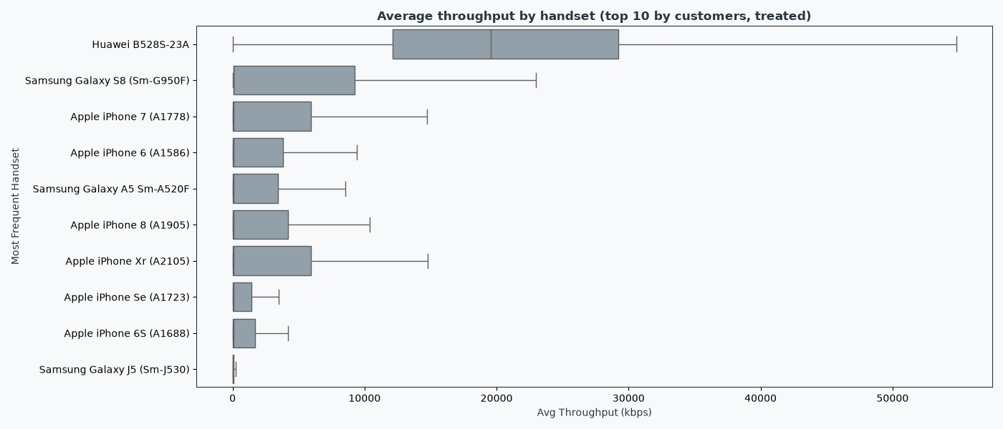
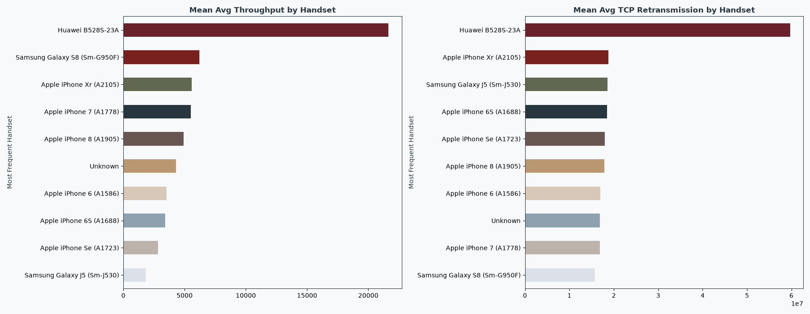
The router is fast;
top phones sit near 40–70 kbps
ε² = 0.328
Throughput differs strongly across the ten handsets, mostly because of the router.
68.0% of router customers sit in the Good experience group.
Router median is 19,571 kbps against 39–68 kbps for the top phones.
TCP is observed for 84% of router customers but only 8–20% of phone customers, so handset TCP comparisons are unreliable.

Slide 15
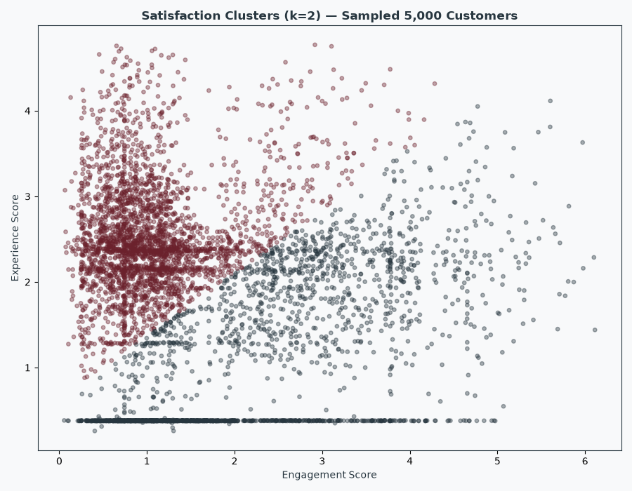
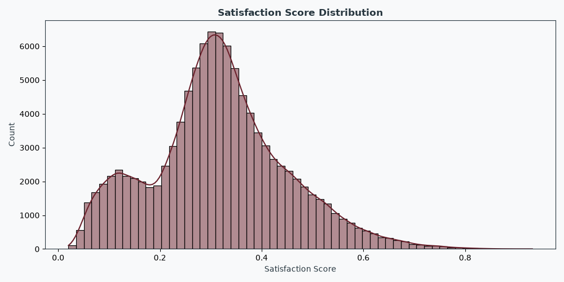
41% of customers
are engaged with weaker experience
Cluster (k = 2) | Customers | Engagement | Experience | Satisfaction
Engaged, weaker experience | 43,694 (40.9%) | 2.33 | 1.21 | 0.295
Less engaged, better experience | 63,162 (59.1%) | 1.07 | 2.55 | 0.331
Top 10 satisfaction scores
What the proxy shows
Satisfaction is the mean of the rescaled engagement and experience scores: average 0.317, median 0.312.
The experience score tracks whether RTT was measured (Spearman −0.660 with the imputed share). Fully imputed RTT averages 0.388; fully observed, 2.378.
Rankings are robust to weighting (Spearman 0.92–0.98), but top-10 lists share only 7–9 names.

Slide 16
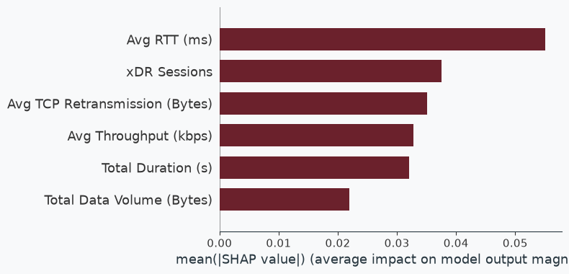
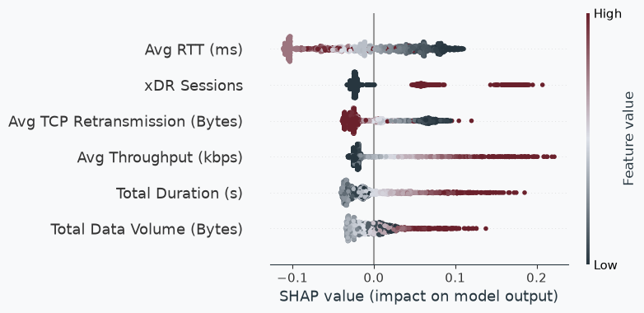
Gradient boosting recovers the score,
not satisfaction
Gradient boosting: R² 0.9921, RMSE 0.0119, MAE 0.0082; CV R² 0.9923 ± 0.0001; train–test gap 0.0002.
The target is a formula of the model's own inputs, so this is formula recovery, not forecasting of real satisfaction.
RTT leads SHAP partly because 16.4% of the 2,000-customer SHAP sample (17.4% of all customers) sits at the imputed RTT (mean SHAP −0.103 against +0.020 for the rest).

Slide 17
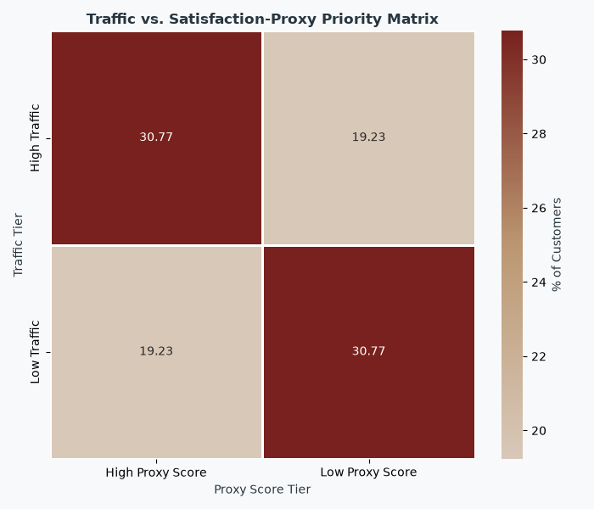
Growth potential is plausible but unproven
Strengths
106,856 customers; traffic moderately concentrated (top 10% carry 21–26%).
Gaming is the only app whose link to volume survives the per-session check (r = 0.986), largely because it is about 87% of the total.
A distinct router segment: 13.25% of sessions (9.9% of customers).
Hypotheses to test
Diagnose the cause of low throughput (device, plan or cell load) in the 40.4% group before any network spend.
Investigate the 25.1% high-latency group only after the RTT gaps are explained.
Review the 19.2% high-traffic, low-score group (20,548 customers, 23.7% of treated and 25.5% of untreated traffic): a candidate, not a confirmed churn risk.
Target the 22.8% High engagement group; test an upgrade offer for previous-generation iPhones.
Risks
No financials.
One week of data.
Network metrics are heavily imputed.

Slide 18
Limitations of the analysis
1. One week, not a month: no trend, seasonality or billing-cycle claim is supported.
2. No revenue, cost, churn, margin, ARPU, survey or location data.
3. TCP is imputed for 63.2% of customers and RTT for 17.4%.
4. Mean replacement changes 15.0% of customers who carry 29.9% of raw traffic.
5. App counters sum to 185% of total volume; some have near-identical distributions.
6. Duration is a bearer-open span with a large 24-hour mass (17.17%).
7. 6.00% of sessions have no usable handset; the router group is inferred from the model name.
8. Satisfaction is a constructed proxy; the regression recovers a formula, with scalers fitted on all customers.
9. Individual top-10 satisfaction lists are unstable: alternative weightings share only 7–9 of 10 names, so use segments, not names.

Slide 19
Recommendation:
continue due diligence
What the data show
106,856 customers. A High engagement group of 22.8% carries about 37% of traffic. One robust network contrast: Good throughput (34.6%) against Low throughput (40.4%).
Required before a buy or pass decision
Revenue, ARPU, cost, margin, churn and customer lifetime value.
A longer, evenly sampled window, plus the rule that produced this extract.
Outcome data (survey, NPS, complaints, churn) to test the proxy.
Cell-level, location, plan and device data, and why RTT and TCP are missing.
Definitions of the Gaming and Other counters, Total DL and UL, and the handset gap.
Untreated segmentation, and every experience result split by router and phone.
What it cannot show
Whether TellCo is profitable, growing or at risk of churn, and what causes the low-throughput pattern.

Slide 20
References
NextHikes IT Solutions (2026). User Analytics in the Telecommunication Industry: problem statement and field descriptions.
TellCo xDR dataset, telcom_data (2).xlsx: 150,001 sessions, 24–30 April 2019 session end dates.
Code and dashboard: https://github.com/srishkyra/NEXTHIKES-IT-SOLUTIONS-Pvt.-Ltd.---PROJECT-5
Pedregosa, F. et al. (2011). Scikit-learn: Machine Learning in Python. Journal of Machine Learning Research, 12, 2825–2830.
McKinney, W. (2010). Data Structures for Statistical Computing in Python. Proc. 9th Python in Science Conference.
Virtanen, P. et al. (2020). SciPy 1.0: fundamental algorithms for scientific computing in Python. Nature Methods, 17, 261–272.
Seabold, S. and Perktold, J. (2010). Statsmodels: econometric and statistical modeling with Python. Proc. 9th Python in Science Conference.
Lundberg, S. and Lee, S.-I. (2017). A Unified Approach to Interpreting Model Predictions. NeurIPS 30.
Friedman, J. H. (2001). Greedy function approximation: a gradient boosting machine. Annals of Statistics, 29(5), 1189–1232.

Slide 21
Thank
You !

